Slide 1
TYPES OF SENSORS

Slide 2
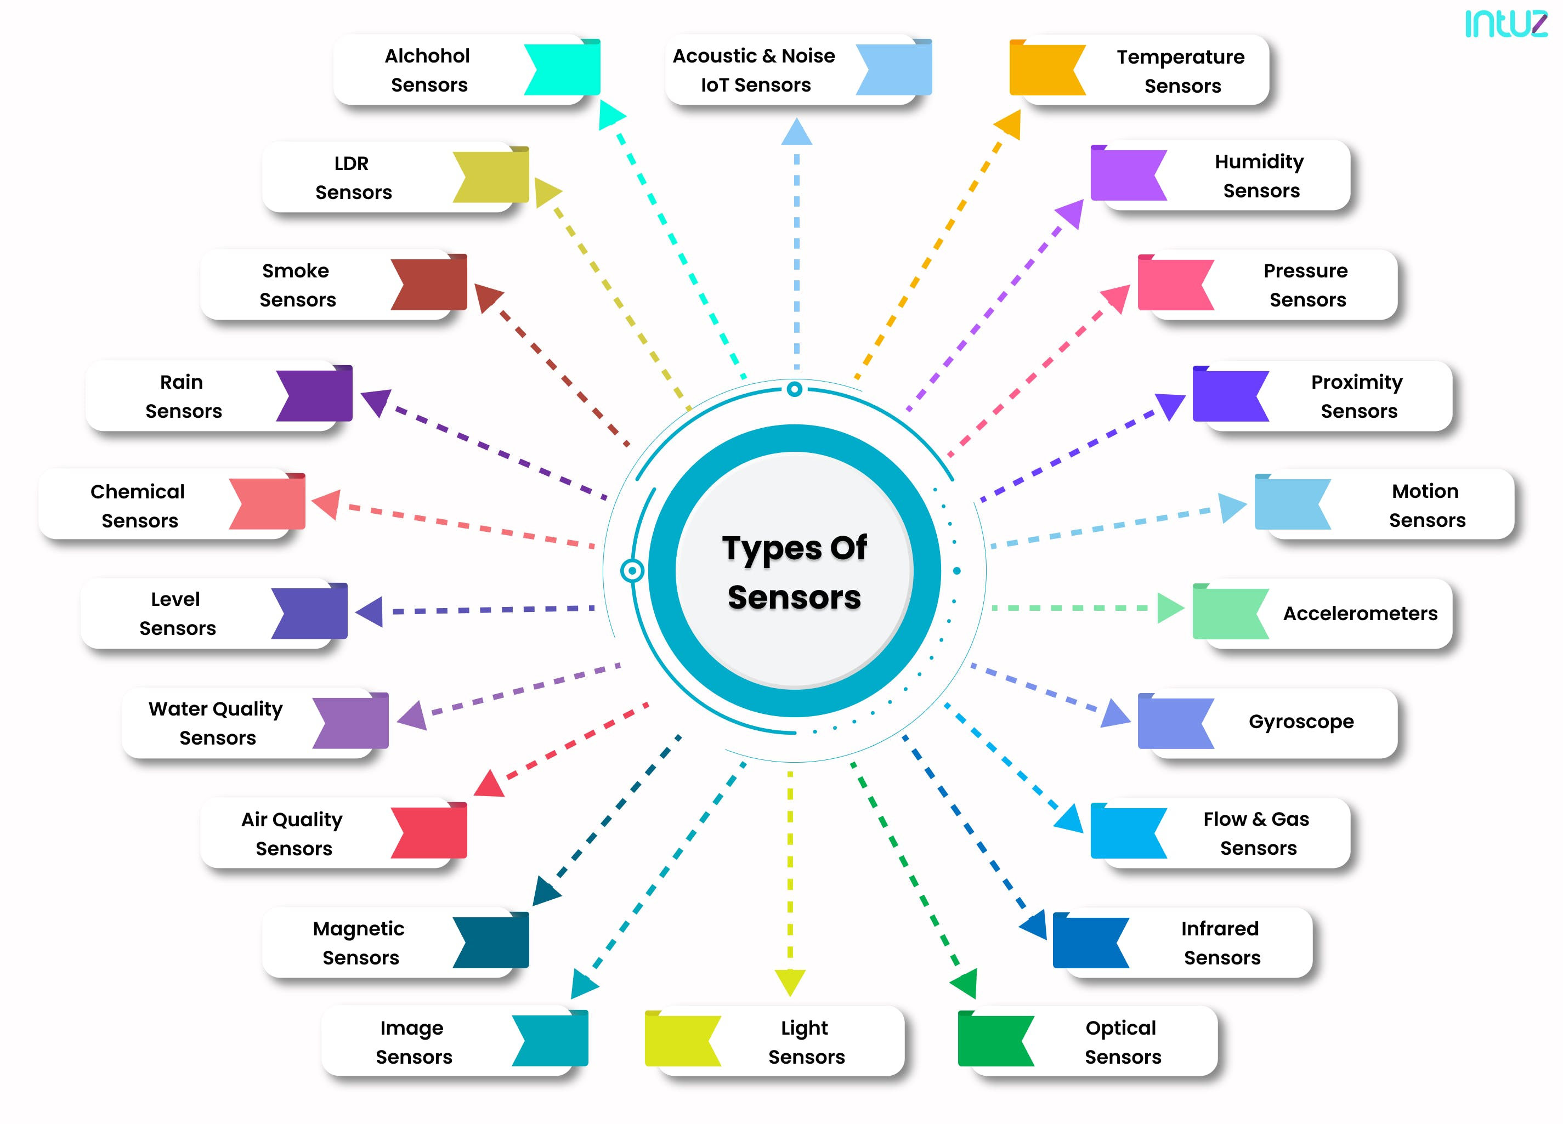

Slide 3
Temperature Sensor
It is used to measure amount of heat energy in an operating environment
Thermocouples: it shows change in voltage based on temperature
Temperature rises then Voltage increases
Thermistors : it is temperature sensitive resistor that changes its physical resistance with the change in temperature
Semiconductors: these are linear devices here the conductivity changes linearly with temperature
Infrared : it detects the temperature by intercepting a portion of emitted infrared energy of the object or substance and sensing its intensity
It can be used to measure temperature of the solids and liquids only
During pandemic these were used to check the body temperature of the person without touching

Slide 4
Proximity Sensor
It is used to detect the presence and absence of near by objects and its properties
Inductive Sensors: they are used for finding the presence of metallic objects and electromagnetic field or beam of electromagnetic radiations
Capacitive Sensors: it can detect both metallic and non metallic objects
Photoelectric Sensors: Photoelectric sensors is made up of light sensitive parts and uses a beam of light to detect the presence or absence of an object
Ultrasonic Sensors: Ultrasonic sensors are also used to detect the presence or to measure the distance of targets similar to RADAR or SONAR

Slide 5
Water Quality Sensor
Chlorine Residual Sensor: it will sense free chlorine present in the water
Organic carbon Sensor: to detect organic elements present in the water
Turbidity Sensor: used to measure suspended particles in the water
Conductivity Sensor: conductivity measurements are carried out in industrial processes to obtain total ionic concentration in water
PH sensor: it is used to measure the PH level of the water to find out whether water is acidic or alkaline
Oxygen-Reduction Potential Sensor: it helps to detect the OXIDATION AND REDUCTION reactions occurring in the solution

Slide 6
Chemical Sensor
It is used to measure chemical reactions and changes
Hydrogen sulphide sensor
Chloride sensor
Zinc oxide sensor
PH glass electrode sensor
Electro chemical gas sensor

Slide 7
Gas Sensors
It is used to monitor changes in the AIR quality and presence of gases in the AIR
Carbon dioxide sensor
Carbon monoxide sensor
Hydrogen sensor
AIR pollution sensor
Nitrogen Oxide sensor
Oxygen monitor
Ozone monitor
Gas Detector

Slide 8
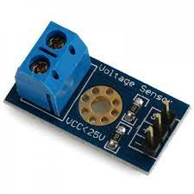
Voltage Sensor
It measures and monitors amount of voltage in electrical equipment or circuit
Small in size, light weight, convenient
Input voltage to this module should not be greater than 25 V
It helps to give alert messages and immediate attention to a problem arises due to voltage variation

Slide 9
Humidity Sensor
It is a device that measures humidity in its environment convert their findings into electrical signal
It is available in various sizes and functionality
They are used in SMART PHONES and also embedded in AIR QUALITY MONITORING SYSTEMs
They are used in METEROLOGICAL department, medical ,automobile department
There are two types of HUMIDITY sensors
RELATIVE HUMIDITY
ABSOLUTE HUMIDITY

Slide 10
Humidity Sensor
RELATIVE HUMIDITY
It is calculated by comparing the live humidity reading at a given temperature to the maximum amount of humidity for air at the same temperature
RH sensor also need to measure temperature
ABSOLUTE HUMIDITY
It is always calculated without any reference to any temperature

Slide 11
Humidity Sensor
Domestic: sensing and controlling humidity in offices and homes are very important since higher humidity conditions affects the blood flow
Industry: In chemical industries if there is high humidity then it reduces oxygen levels in the air and reduces fire rate in furnaces
Agriculture: humidity will decide amount of moisture in air and in soilthet will affect the irrigation
Electronics and semiconductor industry: all electronic devices are rated with a range of humidity values in which they are expected to work. Minute change in humidity level will have huge impact on production
Medical: in medical field incubators ,ventilators etc requires perfect humidity control

Slide 12
Level Sensor
It is used to detect the level of liquids and other fluids including slurries granular material etc
There are two types of level sensors
Continuous level Sensors: this measures level in the specified range and determines exact value of substance
Example fuel in the automobiles
Point level Sensors: this indicates if the substance above or belove threshold point
https://www.youtube.com/watch?v=EMotg3BQjlI

Slide 13
USB sensors
To make sensors to be used easily many companies are manufacturing sensors in USB packaging
Plug such sensors into a PC and USB compatible device and record whatever we want to monitor based on sensor chosen
These are easy to handle and use
They are available to measure temperature , humidity, pressure and noise level
They are also available to measure air quality in industrial and dusty places
It is not A DIFFERENT TYPE OF SENSOR JUST PAKAGING IS DIFFERENT

Slide 14
Embedded Sensors
Like USB sensors these sensors do have different packaging
It has different packaging so multiple sensors can be accommodated in a single device
SMART PHONE: has multiple sensors to help many applications like finger print recognition, facial recognition, removing background noise, detecting noise level etc
SMART WATCH: it helps you to monitor various health related parameters using various sensors in embedded packaging

Slide 15
Wireless Sensor Network
It is large collection of sensor devices that can monitor several physical conditions
All the sensors in the network will work together to sense and to measure their operating environment characteristics
A sensor network could be wired or wireless
In WSN each sensor will be called as sensor node
A sensor node can monitor several physical conditions like pressure, temperature, illumination of light, wind speed and humidity etc
Collected information will be sent to the processing center via WSN gateway
WSN gateway is also called as Base station or Sink node
The processing center evaluates the information received from various sensor nodes and the send instructions to the connected devices

Slide 16
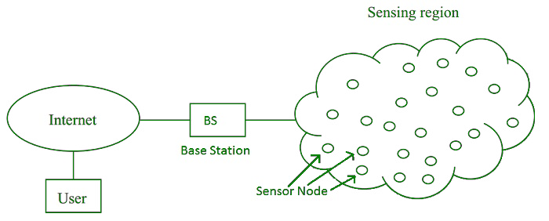
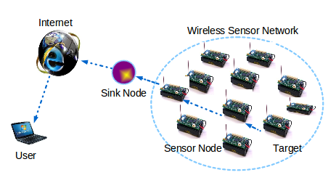
Wireless Sensor Network

Slide 17
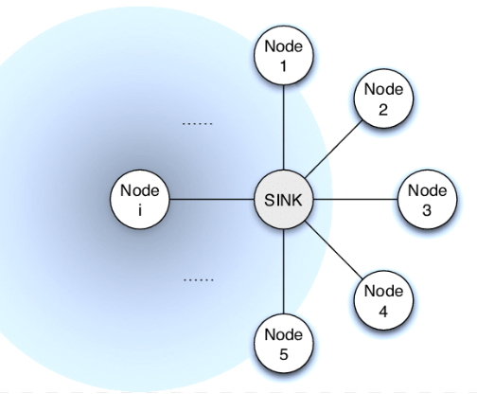
STAR-Topology in WSN
There is a single base station or sink node acts as HUB
Every sensor will be connected to the HUB
Base station sends data to processing unit
Processing unit could be LOCAL OR REMOTE LIKE CLOUD
It is easy to implement, design and expand

Slide 18
TREE-Topology in WSN
There is a single base station or sink node called as ROOT NODE
IT HAS MULTIPLE INTERMEDIATE NODES
Many sensor nodes are connected to intermediate nodes
There are many intermediate nodes
Intermediate nodes are connected to each other or connected to ROOT NODE
Every root node is directly connected to sensors or many intermediate nodes
HIERARCHY would be continued as per requirement and intelligence
Processing power, energy consumption is highest at the root node
It is not very easy to implement, design and expand

Slide 19
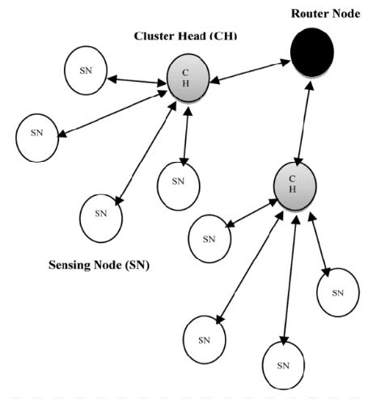
TREE-Topology in WSN

Slide 20
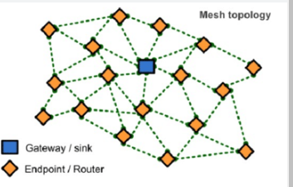
MESH-Topology in WSN
Apart from transmitting its own data , each node could act as relay to transmit data
There are two types
FULLY CONNECTED MESH
PARTIALLY CONNECTED MESH

Slide 21
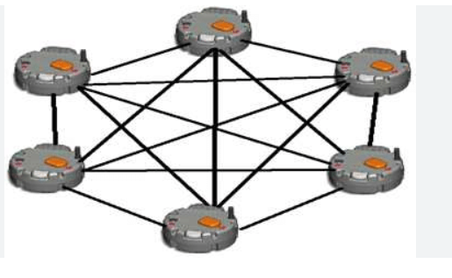
MESH-Topology in WSN
FULLY CONNECTED MESH
Where node is connected to every other node of the network
PARTIALLY CONNECTED MESH

Slide 22
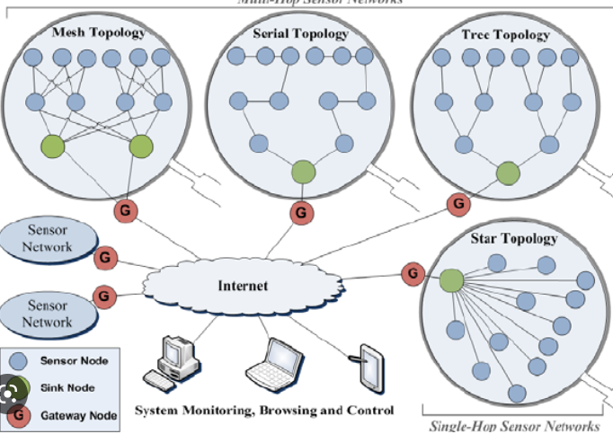
Topology in WSN

Slide 23
Actuators
They carry out desired function by controlling system
Example robotic arm, sound alarm
They can be related to our hand and legs
They can do various functions under the instruction of brain

Slide 24
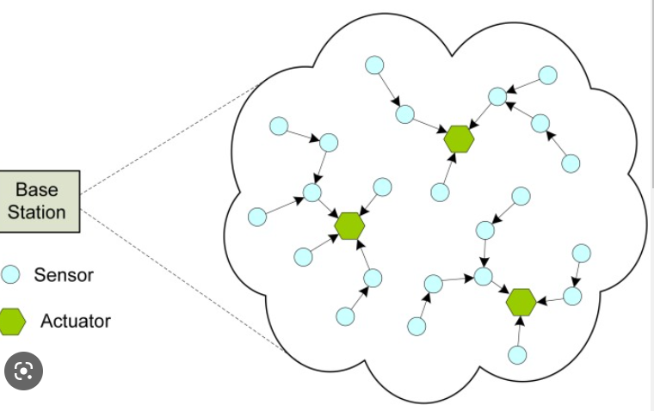
Types of Actuators
Hydraulic-fluid based motor uses the power of HYDRAULICS to create action
Thermal – they uses magnetic energy to perform action
Electrical they work on AC and DC and turn into mechanical energy
Pneumatic- they use Vacuum or Compressed air to make energy into actions

